Slide 1


AJAY .P 13/08/2025.
GDP & P PULATI N – ANALYSIS..

Slide 2


PROJECT OVERVIEW :-
Analyze global economic and demographic data (population, GDP, literacy, infant
mortality) from SQL and Excel sources using Power BI to uncover trends and
relationships.
Goals
Clean, merge, and prepare multi-source datasets.
Perform descriptive statistics and DAX calculations.
Build an interactive Power BI dashboard.
Highlight key global trends, rankings, and correlations.

Slide 3

Dataset Overview:-
Countries World (SQL) – Country details: population, GDP per capita, literacy, infant mortality, birth/death rates, economy sectors, etc.
PopulationPerCountry.xlsx – Annual population data (1960–2017) for each country.
Meta Data Country.xlsx – Region, income group, and special notes for each country.
GDP by Country 1960–2016.xlsx – Historical GDP data by country and year.

Slide 4
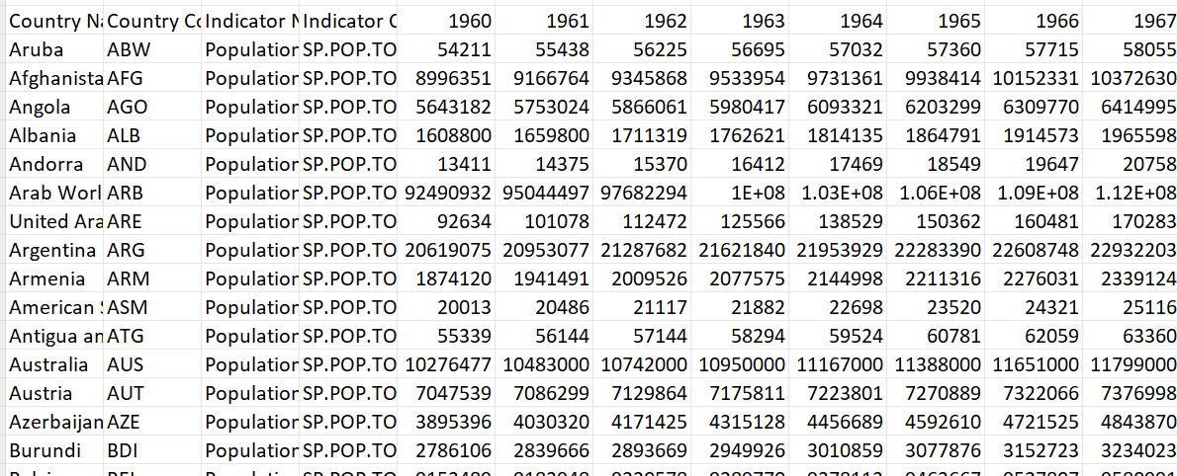
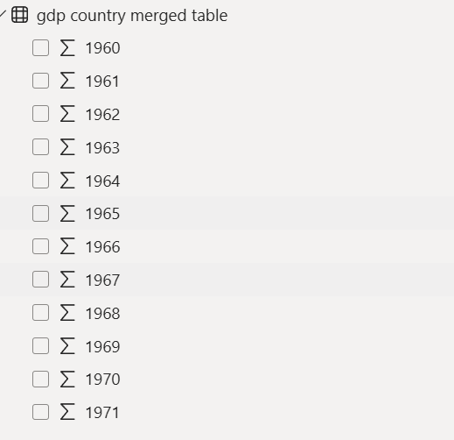

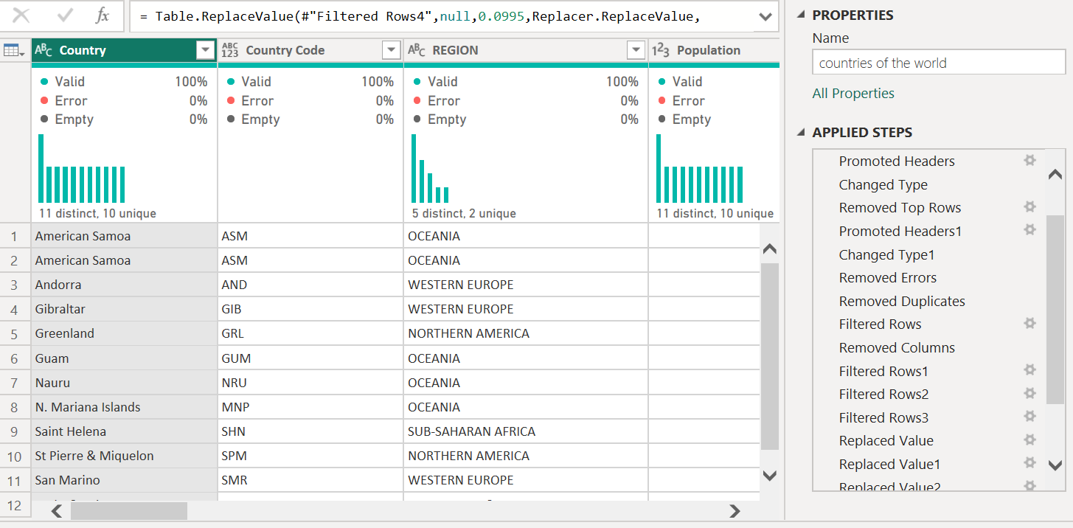

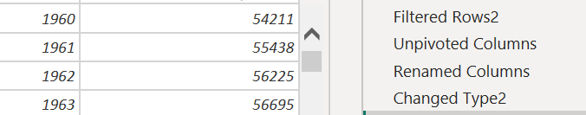

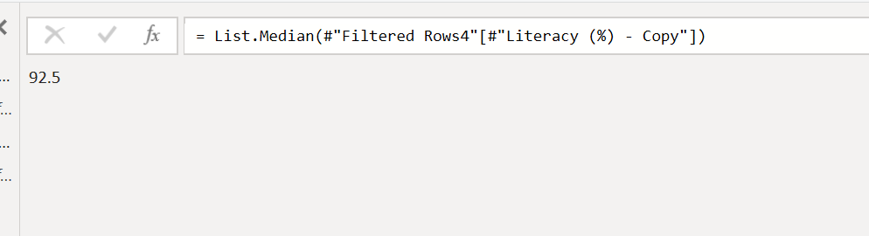
Data Cleaning & Transformation:-
Data Cleaning
Un pivoting
Removed duplicates & irrelevant records.
Handled missing values (median/regional averages).
Converted data types for consistency.
Merged datasets using Country Code & Country Name.
Unpivoted year columns for time-series analysis.
Created DAX measures for GDP/Population growth & per capita values.
Replace with median

Slide 5

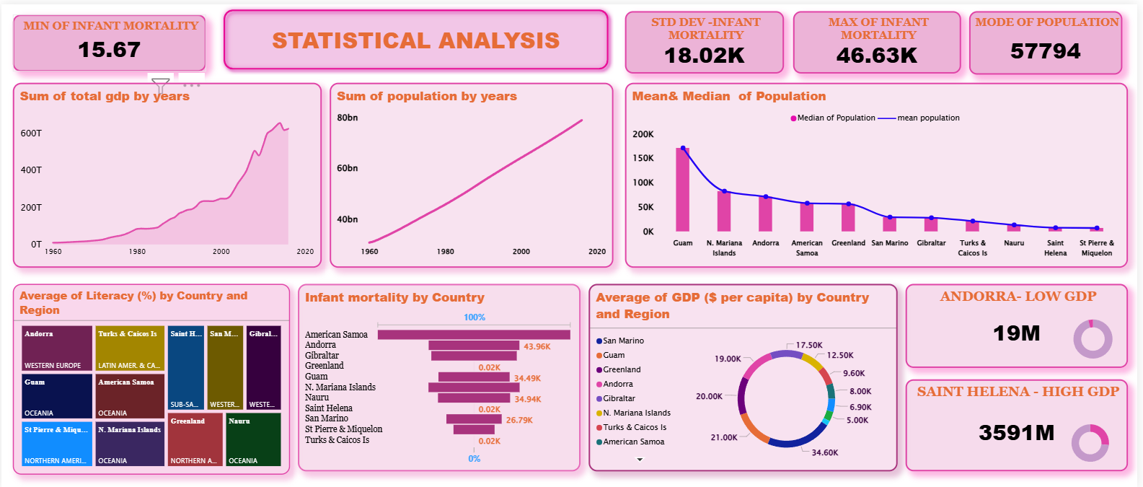
Statistical Analysis:-
Basic stats for population, GDP, literacy, infant mortality.
Highest & lowest GDP per capita.
Regional averages & distributions.
Growth trends (1960–2017).

Slide 6

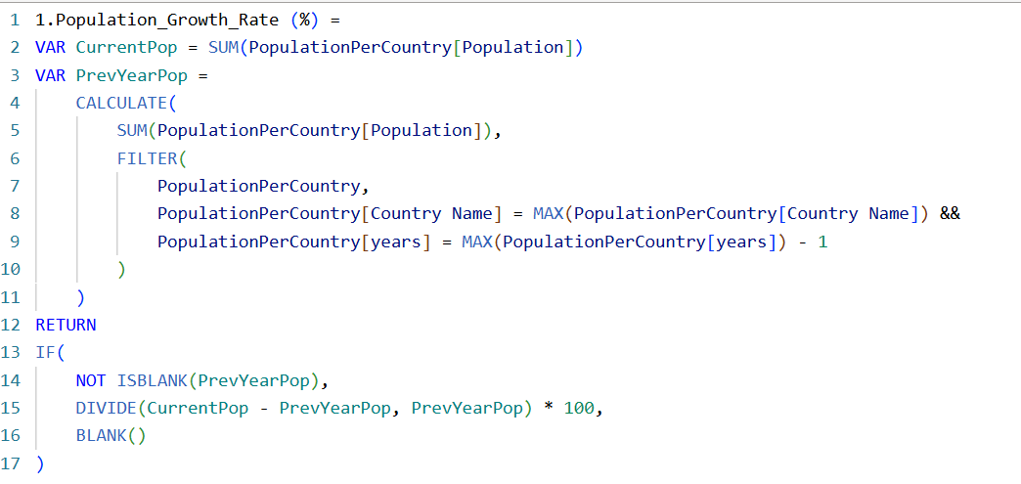
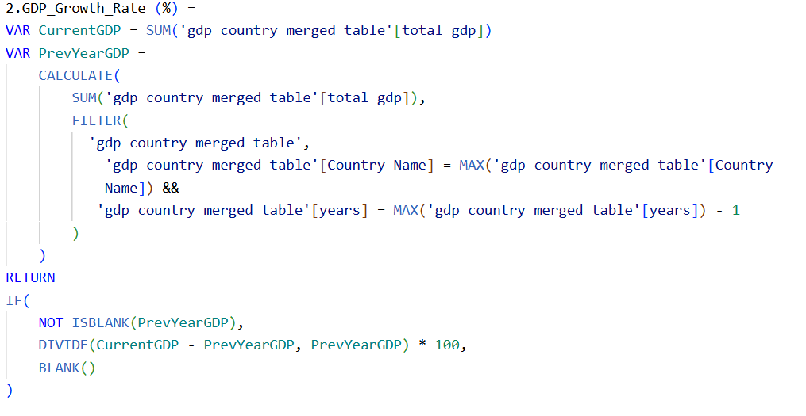
DAX Functions :-
Some Dax snippet’s
DAX Functions ;
Population Growth Rate = % change over years.
GDP Growth Rate = % change over years.
GDP per Capita = GDP ÷ Population.
Regional GDP / Population = SUM by region.
GDP–Literacy Correlation .

Slide 7






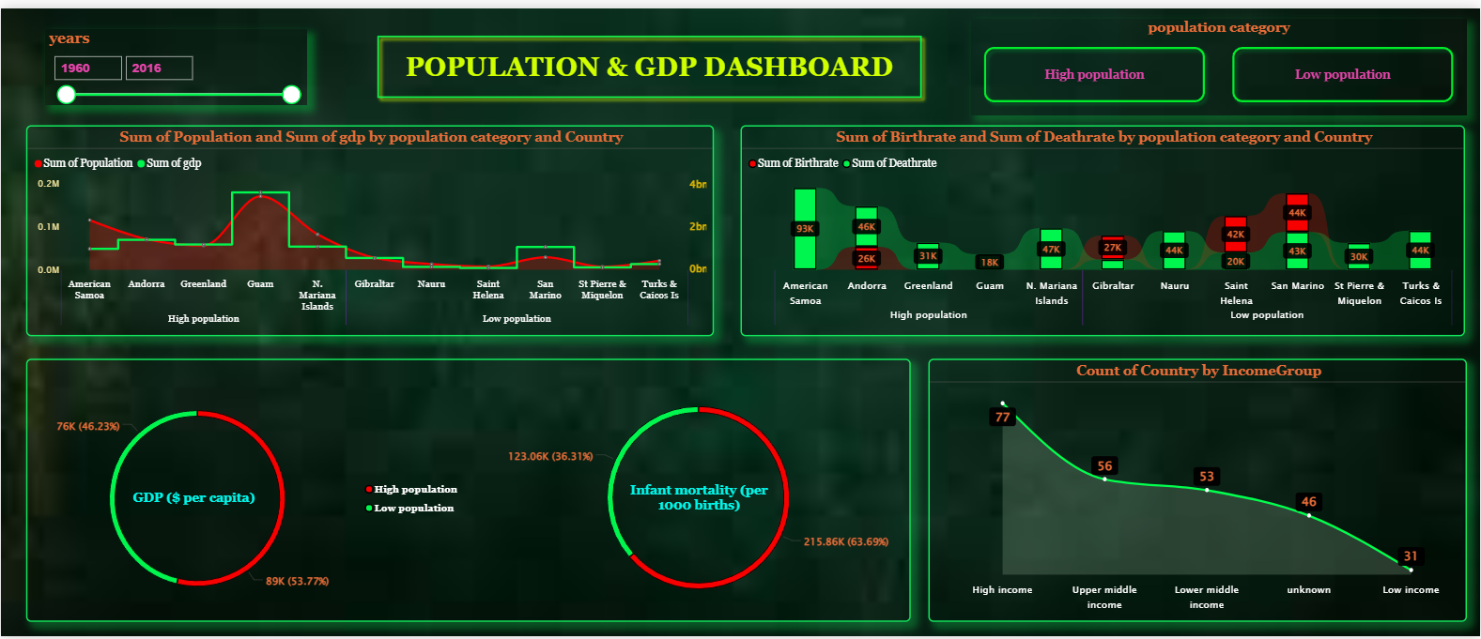
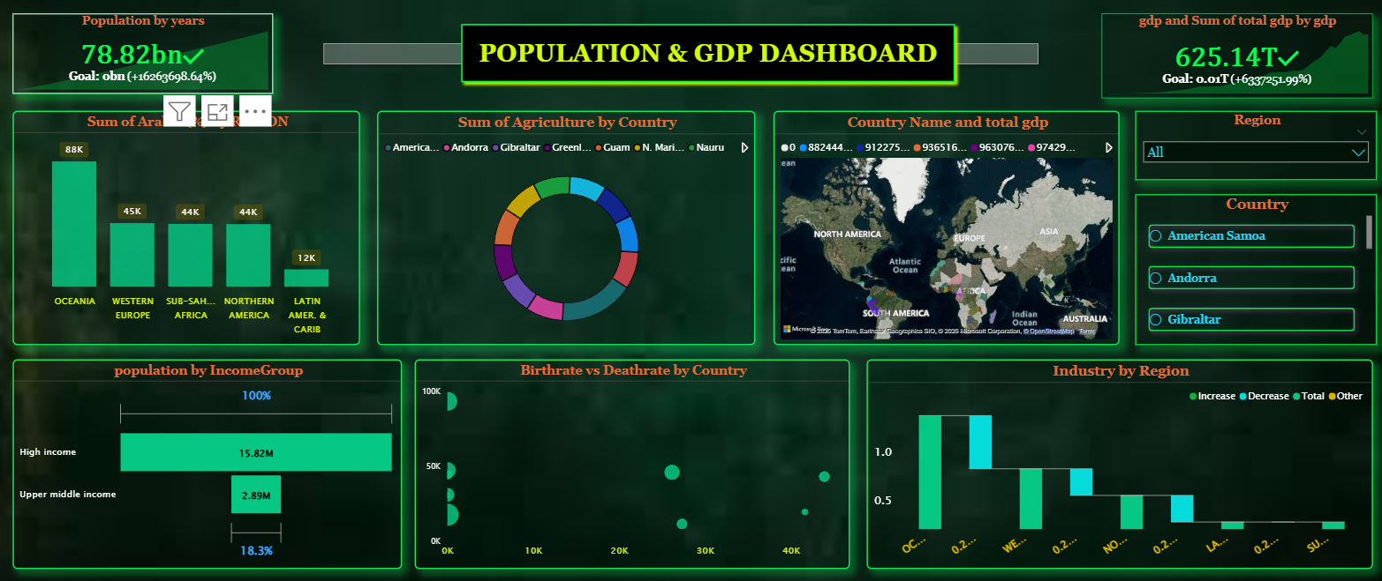
GDP & Population Dashboard’s
List Slicer for Region
Dual Charts for population & GDP
Button slicers for pop - category
KPI’s for GDP by year
"Dashboard Visual Insights" – all charts collectively providing an interactive view of the data for analysis..

Slide 8

Key insights :-
Oceania has the highest population growth rate (382,352).
Andorra (19000) has the highest and Saint Helena (2500) the lowest GDP per capita.
Infant mortality is significantly lower in high-income regions.
Western Europe (3,989.70) has the highest and North America (0.00) the lowest population density.
GDP growth strongly correlates with literacy rates in most regions

Slide 9

Conclusion :-
High-income regions have higher GDP per capita and lower infant mortality.
Developing regions show rapid population growth but face economic and health challenges.
Literacy rates strongly correlate with GDP growth in most regions.
The interactive dashboard enables deeper exploration for data-driven decisions

Slide 10
THANK YOU !!!
ANY QUESTIONS ?

